Slide 1
Building Neural Networks with PyTorch

Slide 2
What are we going to do this afternoon
Introduction neural networks
Neural networks
Architecture
Training
Neural networks in practice
Case study: Company default prediction

Slide 3

Neural networks

Slide 4
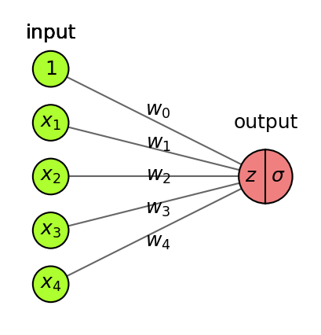
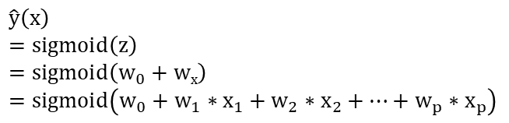
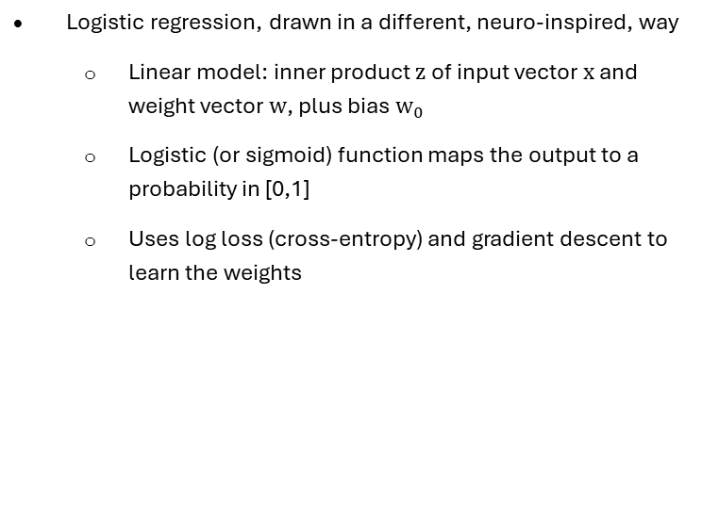
From logistic regression
Logistic regression, drawn in a different, neuro-inspired, way
Linear model: inner product z of input vector x and weight vector w, plus bias $w_{0}$
Logistic (or sigmoid) function maps the output to a probability in [0,1]
Uses log loss (cross-entropy) and gradient descent to learn the weights
$$\hat{y}\left(x\right)$$
$$=\text{sigmoid}\left(z\right)$$
$$=\text{sigmoid}\left(w_{0}+wx\right)=\text{sigmoid}\left(w_{0}+w_{1}∗x_{1}+w_{2}∗x_{2}+…+w_{p}∗x_{p}\right)$$

Slide 5
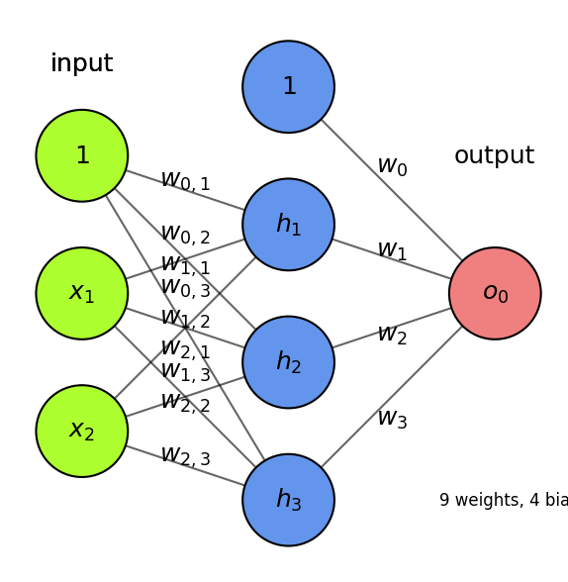
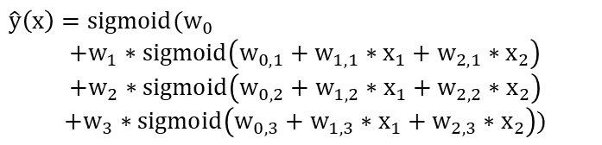
To neural networks
Add one (or more) hidden layers h with k nodes (or units, cells, neurons)
Every ‘neuron’ is a tiny function, the network is an arbitrarily complex function, in the simplest form it weighs, sums the inputs and applies an activation function
Weights w_{i,j} between node i and node j form a weight matrix W_{l} per layer l
$$\hat{y}\left(x\right)={sigmoid(w}_{0}$$
$$+w_{1}∗\text{sigmoid}\left(w_{0,1}+w_{1,1}∗x_{1}+w_{2,1}∗x_{2}\right)$$
$$+w_{2}∗\text{sigmoid}\left(w_{0,2}+w_{1,2}∗x_{1}+w_{2,2}∗x_{2}\right)$$
$$+w_{3}∗\text{sigmoid}\left(w_{0,3}+w_{1,3}∗x_{1}+w_{2,3}∗x_{2}\right))$$

Slide 6
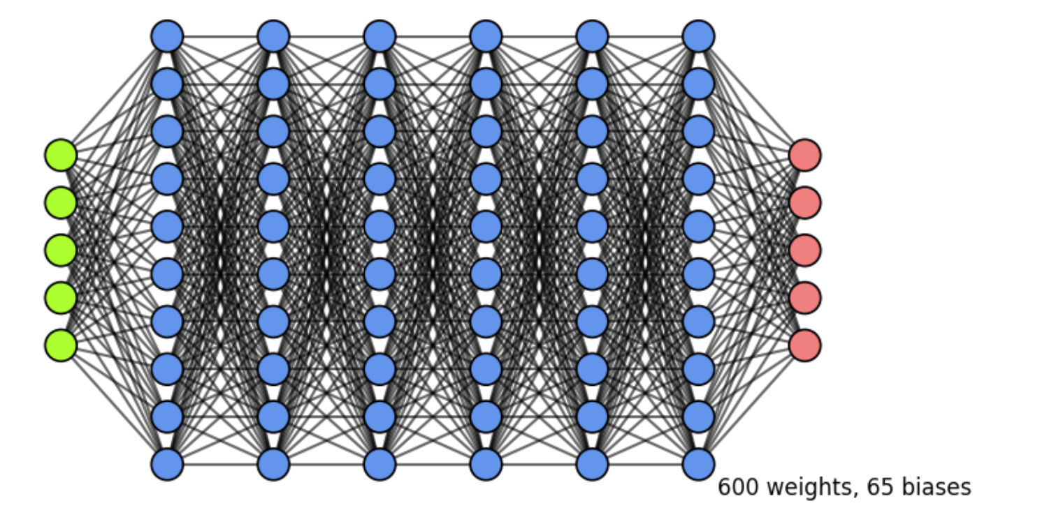
Adding more layers
Add more layers, and more nodes per layer, to make the model more complex
For simplicity, we don’t draw the biases (but remember that they are there)
In dense (fully-connected) layers, every previous layer node is connected to all nodes
The output layer can also have multiple nodes (e.g. 1 per class in multi-class classification)

Slide 7
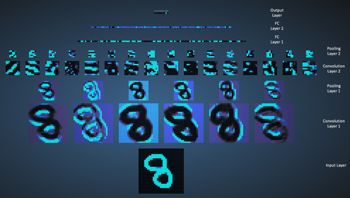
Why more layers
Each layer acts as a filter and learns a new representation of the data
Subsequent layers can learn iterative refinements
Easier that learning a complex relationship in one go
Example: for image input, each layer yields new (filtered) images
Can learn multiple mappings at once: weight tensor \(\mathit{W}\) yields activation tensor \(\mathit{A}\)
From low-level patterns (edges, end-points, …) to combinations thereof
Each neuron ‘lights up’ if certain patterns occur in the input

Slide 8
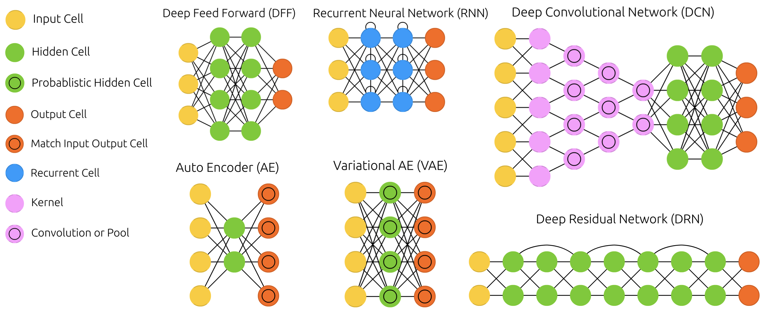
Architectures

Slide 9
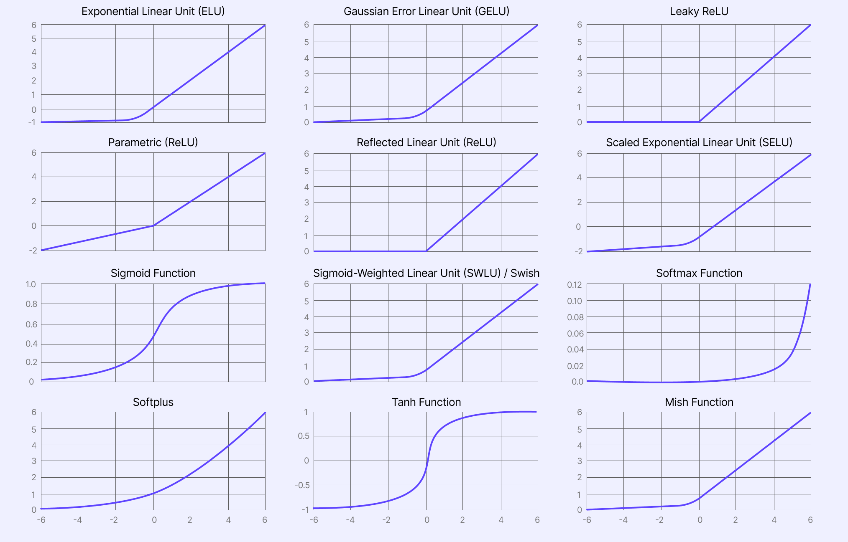
Activation functions

Slide 10
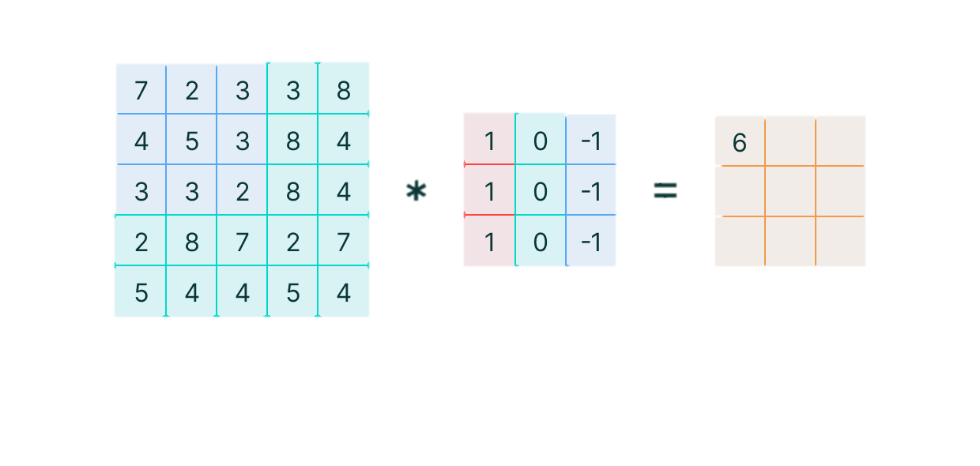
Convolution layer

Slide 11
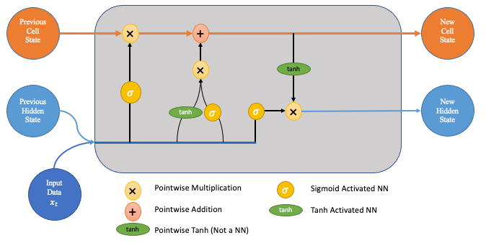
Long short term memory layer

Slide 12
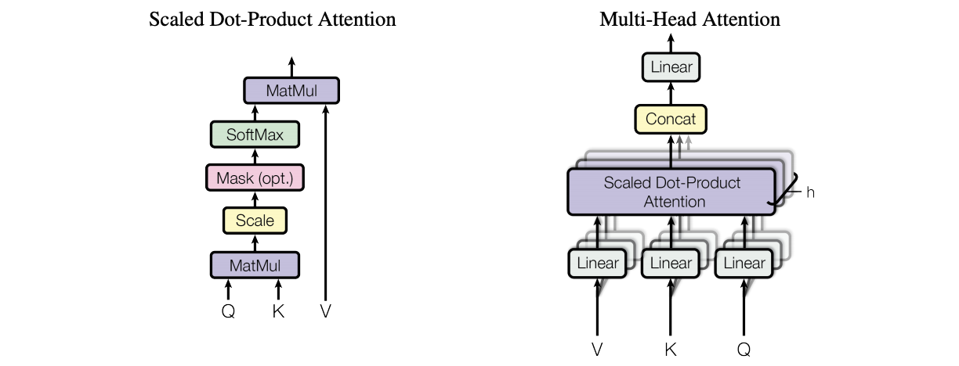
Attention layer

Slide 13
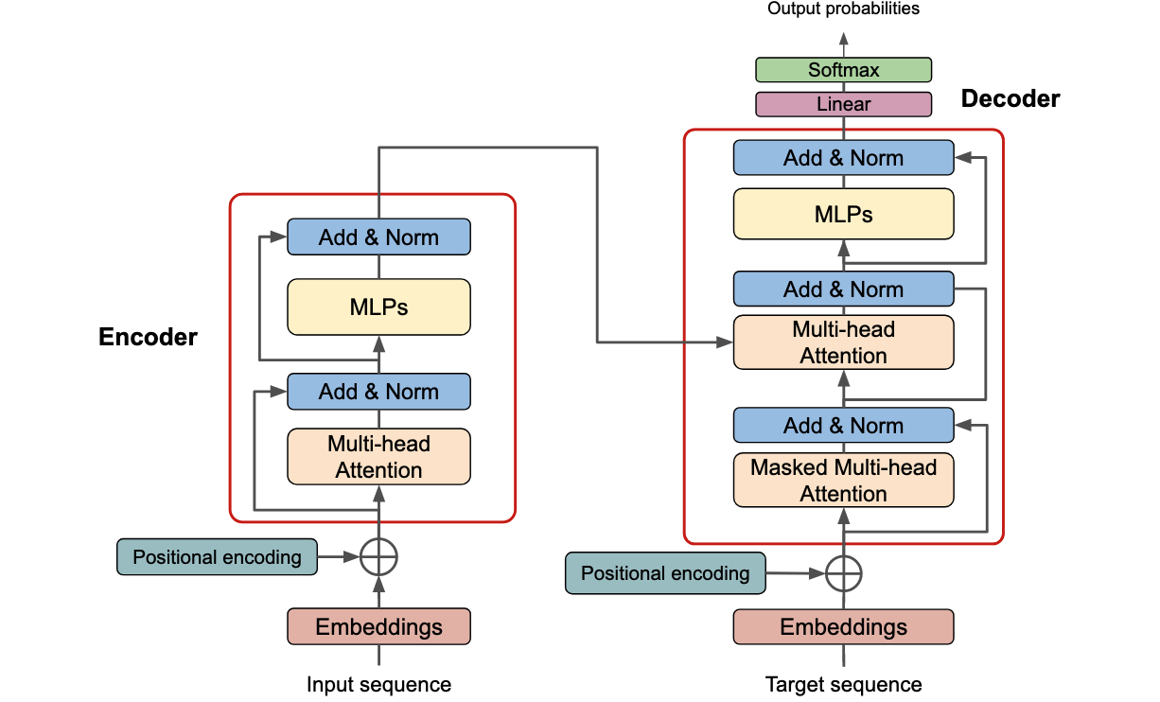
Transformer layers

Slide 14
Preprocessing
Preprocessing: Normalisation, Reshaping, Encoding
Always normalize (standardize or min-max) the inputs. Mean should be close to 0.
Avoid that some inputs overpower others
Speed up convergence
Gradients of activation functions are (near) 0 for large inputs
If some gradients become much larger than others, SGD will start zig-zagging
Reshape the data to fit the shape of the input layer, e.g. (n, 28*28) or (n, 28,28)
Tensor with instances in first dimension, rest must match the input layer
In multi-class classification, every class is an output node, so one-hot-encode the labels
e.g. class ‘4’ becomes [0,0,0,0,1,0,0,0,0,0]

Slide 15
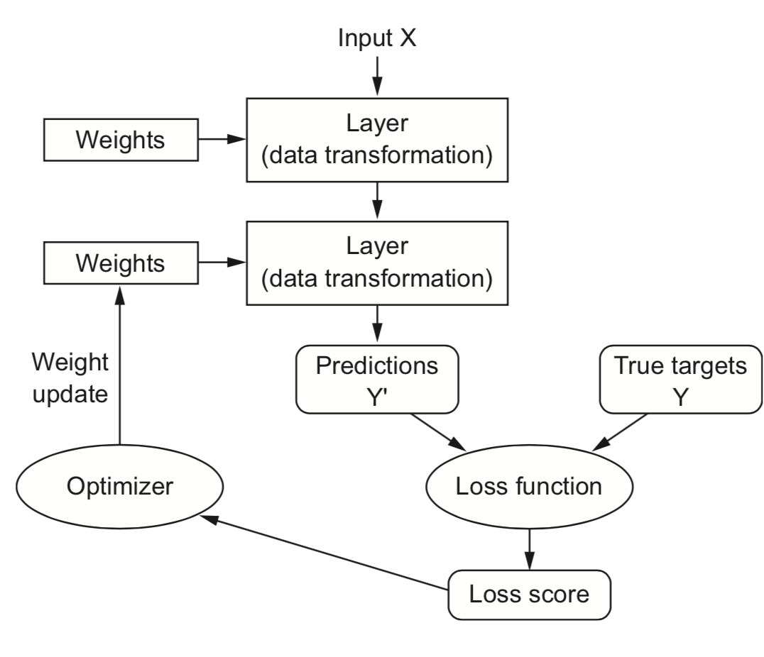
Training neural networks
Initialisation
Training loop

Slide 16
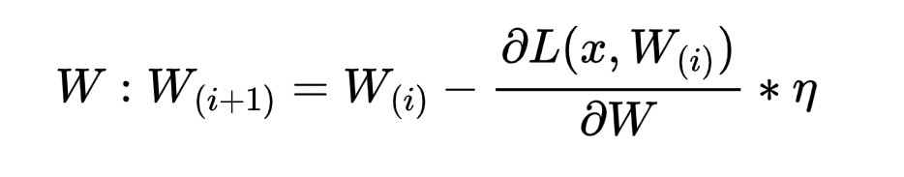
Training algorithms
Mini-batch Stochastic Gradient Descent
Draw a batch from the training data X and y
Forward pass: pass X though the network to yield predictions ŷ
Compute the loss L (mismatch between ŷ and y)
Backward pass: Compute the gradient of the loss with regard to every weight
Backpropagate the gradients through all the layers
Update
Repeat until n passes (epochs) are made through the entire training set

Slide 17
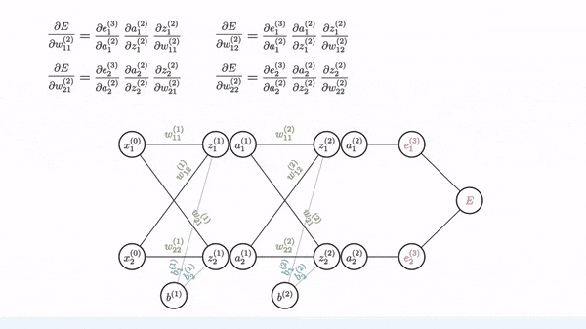
Backpropagation

Slide 18
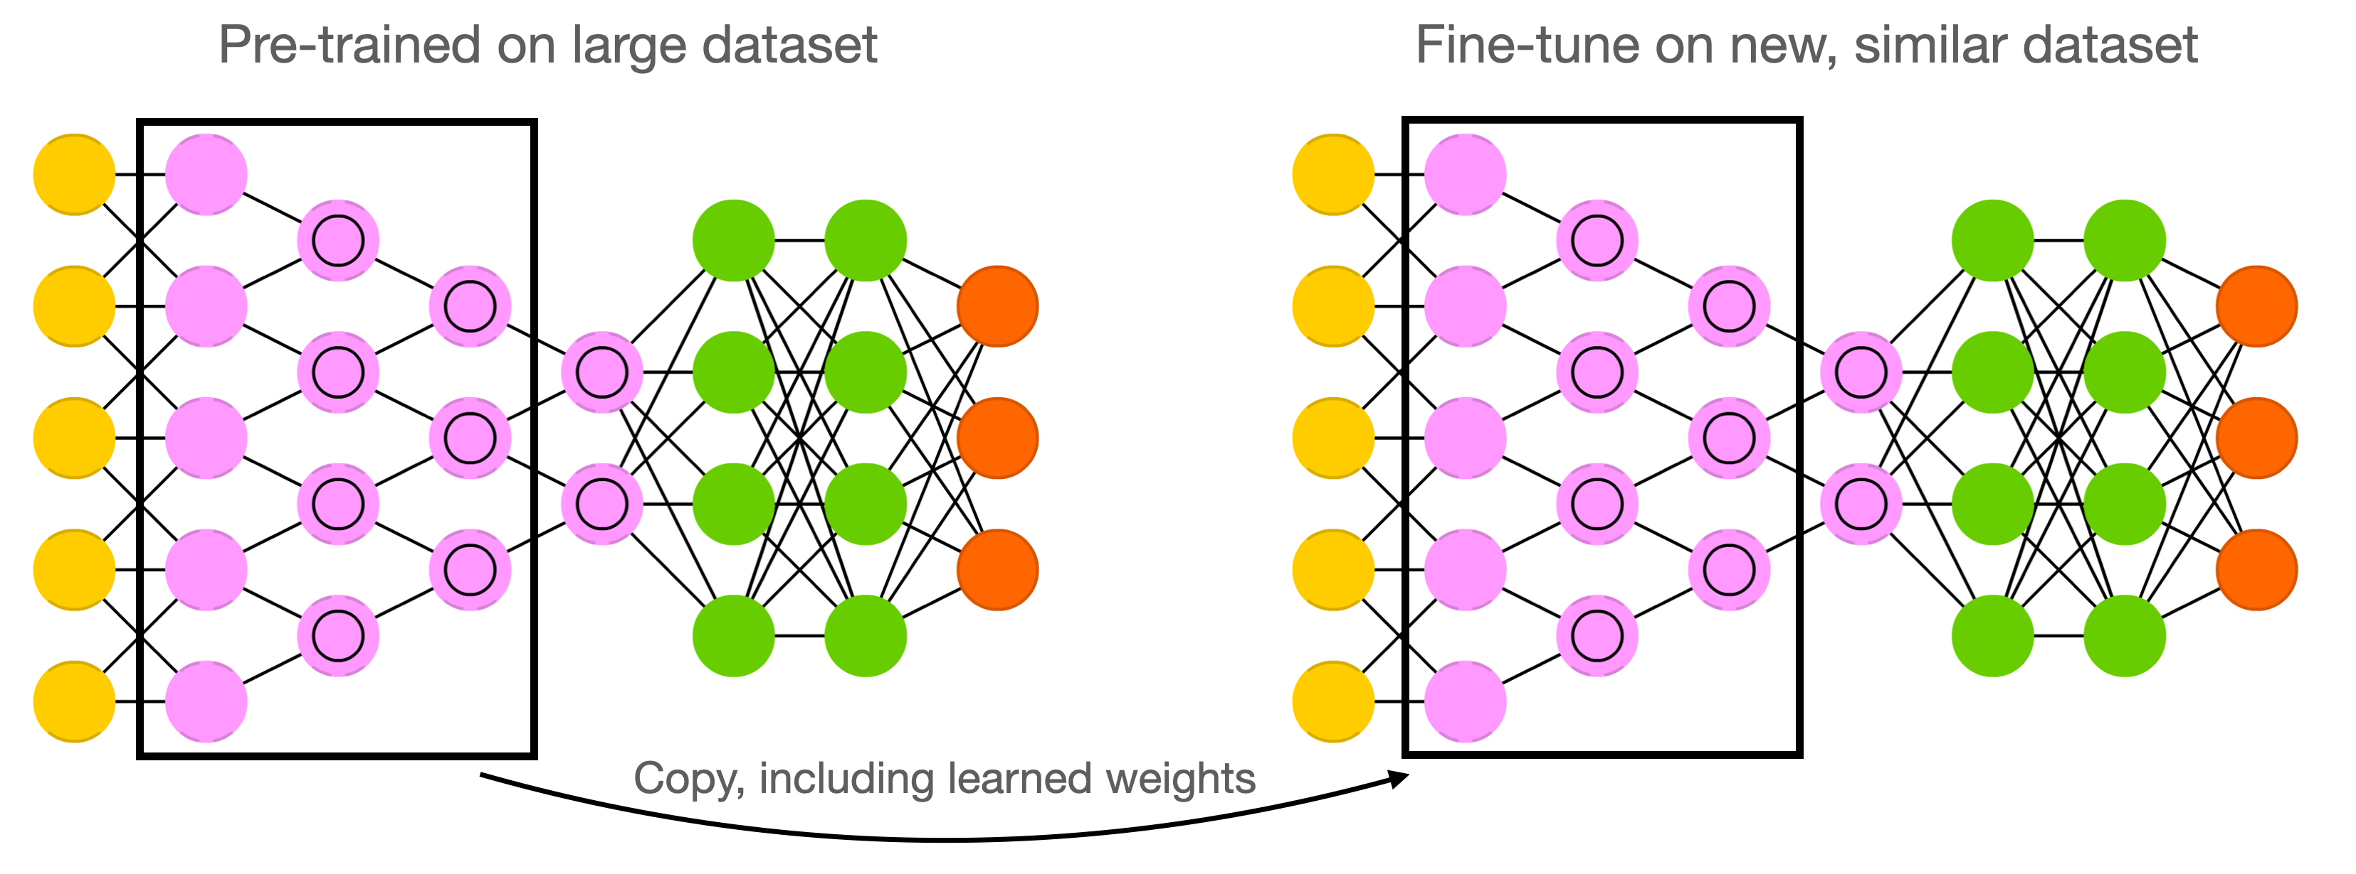
Transfer learning
Instead of starting from scratch, start from weights previously learned from similar tasks
This is, to a big extent, how humans learn so fast
Transfer learning: learn weights on task T, transfer them to new network
Weights can be frozen, or finetuned to the new data
Only works if the previous task is ‘similar’ enough
Generally, weights learned on very diverse data (e.g. ImageNet) transfer better
Meta-learning: learn a good initialization across many related tasks

Slide 19
Optimisers
Momentum
Imagine a ball rolling downhill: accumulates momentum, doesn’t exactly follow steepest descent
Reduces oscillation, follows larger (consistent) gradient of the loss surface
Adds a velocity vector
Nesterov momentum: Look where momentum step would bring you, compute gradient there
Responds faster (and reduces momentum) when the gradient changes
Adaptive gradients
‘Correct’ the learning rate for each weight based on specific local conditions (layer depth, fan-in,…)
Adagrad: scale η according to squared sum of previous gradients
RMSProp: use moving average of squared gradients
Adam (Adaptive moment estimation)
Adam: RMSProp + momentum.
Adds moving average for gradients as well
Adds a bias correction to avoid small initial gradients

Slide 20
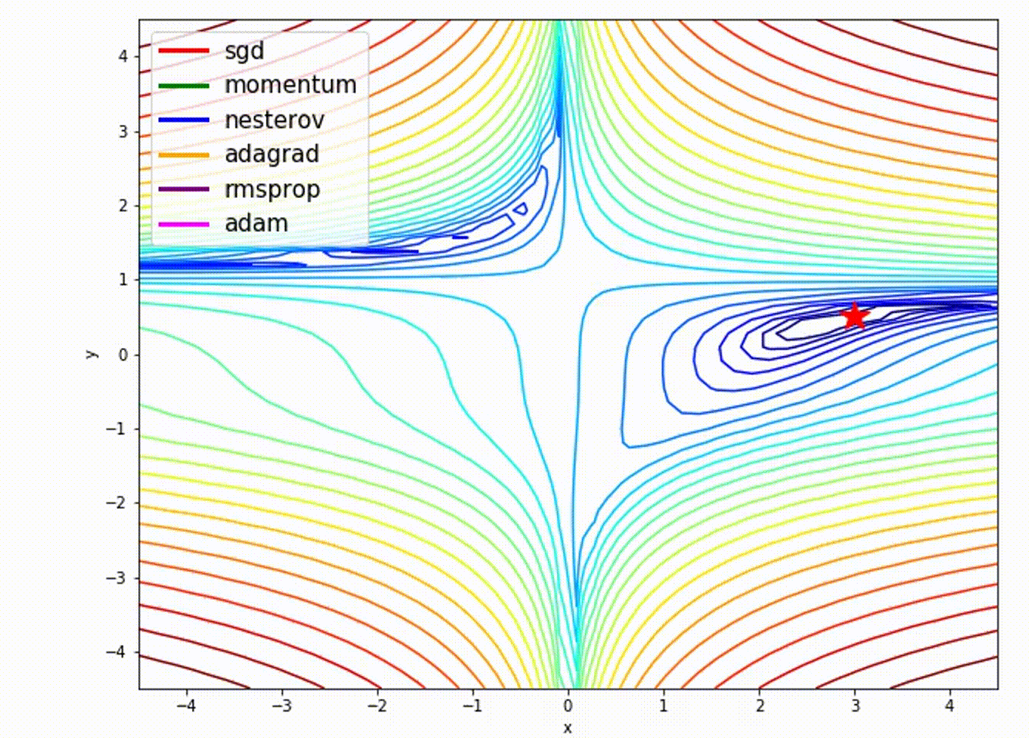
Performance

Slide 21
Performance
Choosing loss, optimizer, metrics
Loss function
Cross-entropy (log loss) for multi-class classification ŷ is one-hot encoded)
Use binary crossentropy for binary problems (single output node)
Use sparse categorical crossentropy if ŷ is label-encoded (1,2,3,…)
Optimizer
Any of the optimizers we discussed before. RMSprop usually works well.
Metrics
To monitor performance during training and testing, e.g. accuracy

Slide 22
Hyperparameters
Choosing training hyperparameters
Number of epochs: enough to allow convergence
Too much: model starts overfitting (or just wastes time)
Batch size: small batches (e.g. 32, 64,… samples) often preferred
‘Noisy’ training data makes overfitting less likely
Larger batches generalize less well (‘generalization gap’)
Requires less memory (especially in GPUs)
Large batches do speed up training, may converge in fewer epochs
Batch size interacts with learning rate
Instead of shrinking the learning rate you can increase batch size

Slide 23
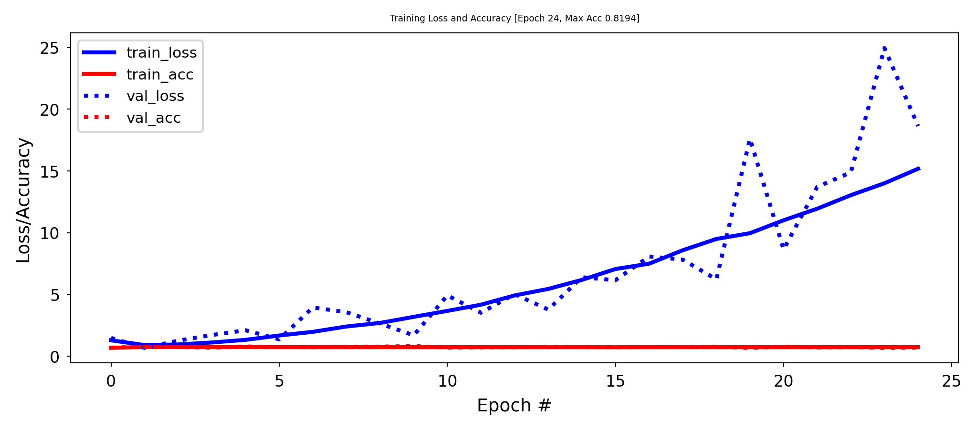
How to know the model is trained well
How many epochs do we need for training?
Train the neural net and track the loss after every iteration on a validation set
You can add a callback to the fit version to get info on every epoch
Early stopping
Stop training when the validation loss (or validation accuracy) no longer improves
Loss can be bumpy: use a moving average or wait for k steps without improvement

Slide 24
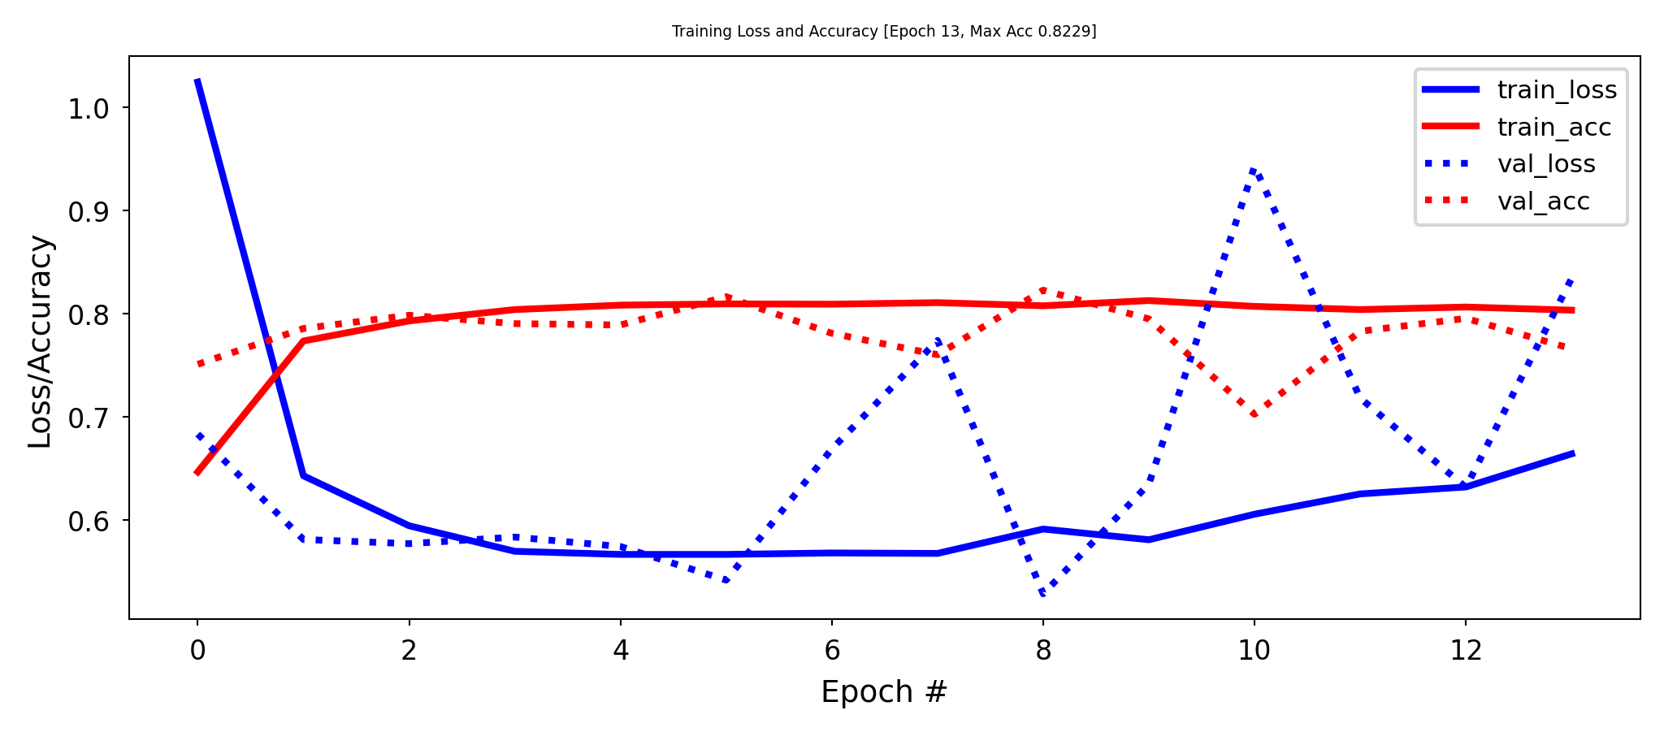
Regularisation and memorisation capacity
The number of learnable parameters is called the model capacity
A model with more parameters has a higher memorisation capacity
Too high capacity causes overfitting, too low causes underfitting
In the extreme, the training set can be ‘memorised’ in the weights
Smaller models are forced it to learn a compressed representation that generalises better
Find the sweet spot: e.g. start with few parameters, increase until overfitting stars.
Example: 256 nodes in first layer, 32 nodes in second layer, similar performance

Slide 25
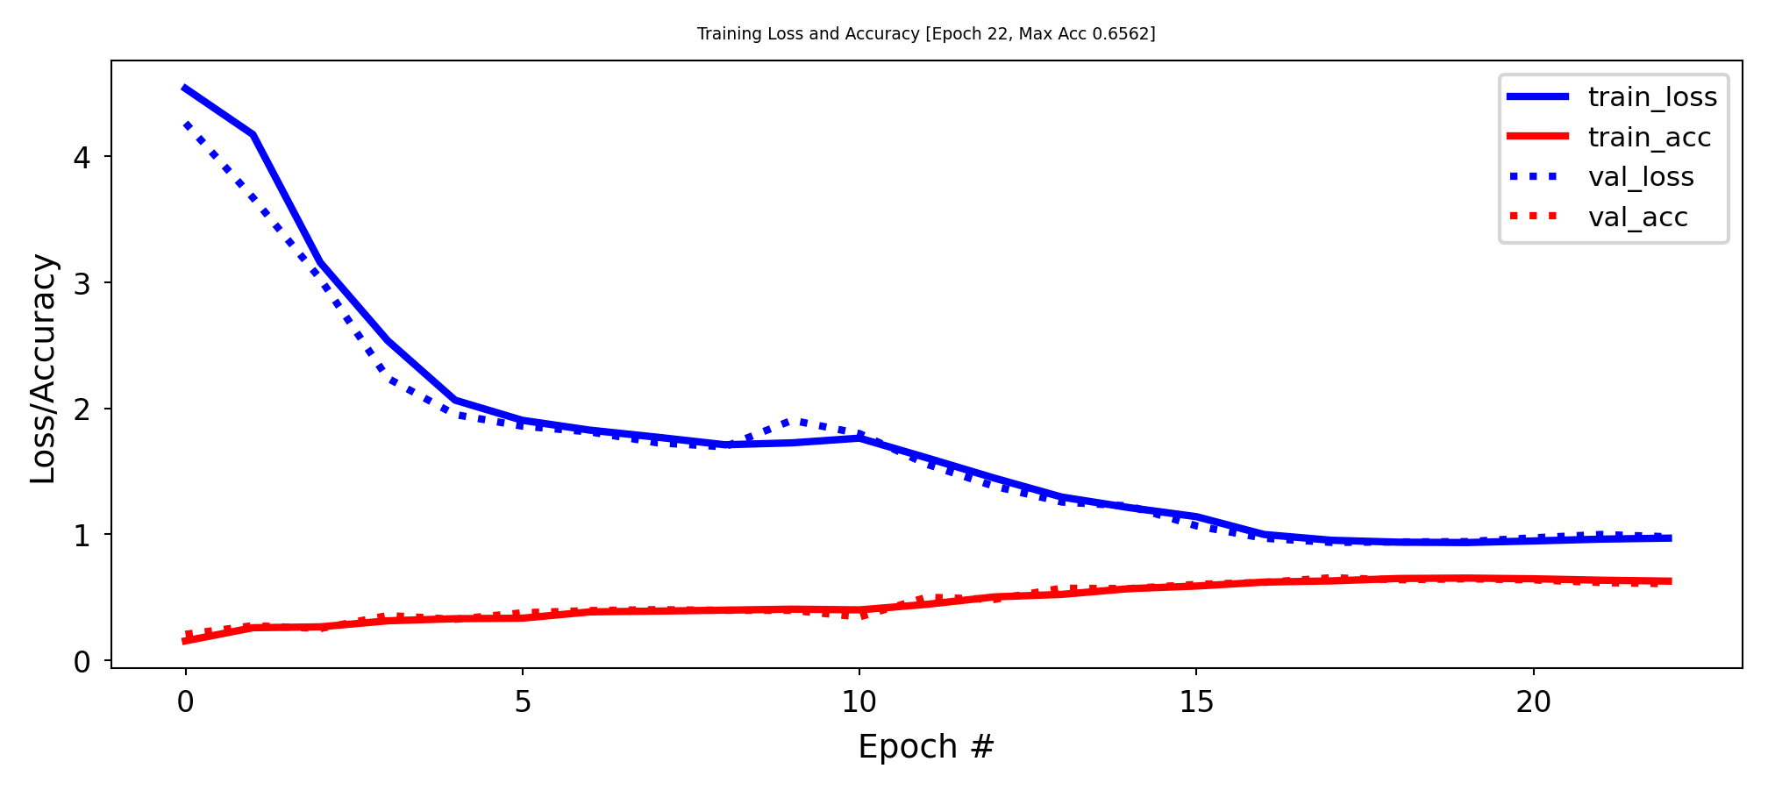
Information bottleneck
If a layer is too narrow, it will lose information that can never be recovered by subsequent layers
Information bottleneck theory defines a bound on the capacity of the network
Imagine that you need to learn 10 outputs (e.g. classes) and your hidden layer has 2 nodes
Example: bottleneck of 2 nodes, no overfitting, much higher training loss

Slide 26
Weight regularisation (weight decay)
As we did many times before, we can also add weight regularization to our loss function
L1 regularisation: leads to sparse networks with many weights that are 0
L2 regularisation: leads to many very small weights

Slide 27
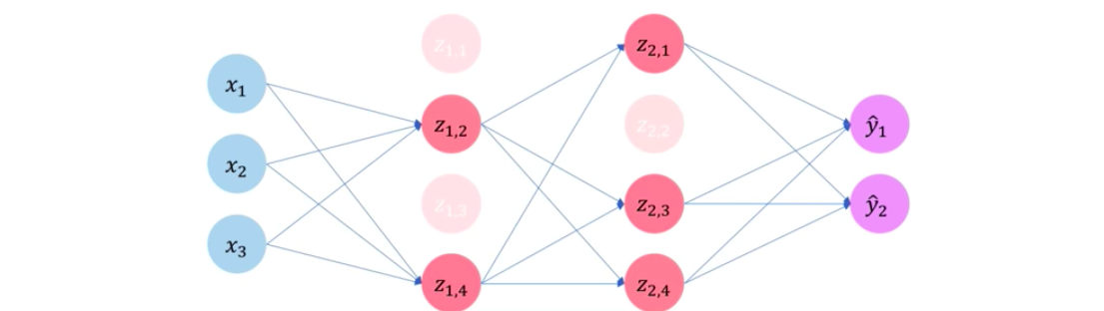
Dropout
Every iteration, randomly set a number of activations a_{i} to 0
Dropout rate : fraction of the outputs that are zeroed-out (e.g. 0.1 - 0.5)
Idea: break up accidental non-significant learned patterns
At test time, nothing is dropped out, but the output values are scaled down by the dropout rate
Balances out that more units are active than during training

Slide 28
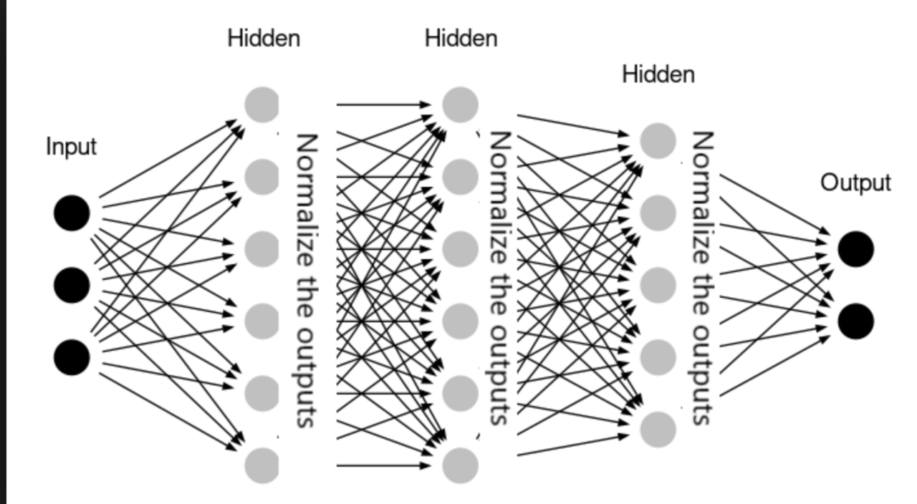
Batch Normalisation
We’ve seen that scaling the input is important, but what if layer activations become very large?
Same problems, starting deeper in the network
Batch normalisation: normalize the activations of the previous layer within each batch
Within a batch, set the mean activation close to 0 and the standard deviation close to 1
Across badges, use exponential moving average of batch-wise mean and variance
Allows deeper networks less prone to vanishing or exploding gradients

Slide 29

Neural Networks in Practice

Slide 30

PyTorch framework
Originally made by Facebook
Since Sept 2022 governed by the independent PyTorch foundation
Focused on GPU calculation on Numpy arrays
Automatic differentiation system

Slide 31

Company Defaults

